Slide 1
Breast Density Notification: A Cost-Effectiveness Analysis
Jason Semprini, MPP

Slide 2
Agenda
Background on breast density & notification laws
Design
Methodology
Results
Interpretation and Implications

Slide 3
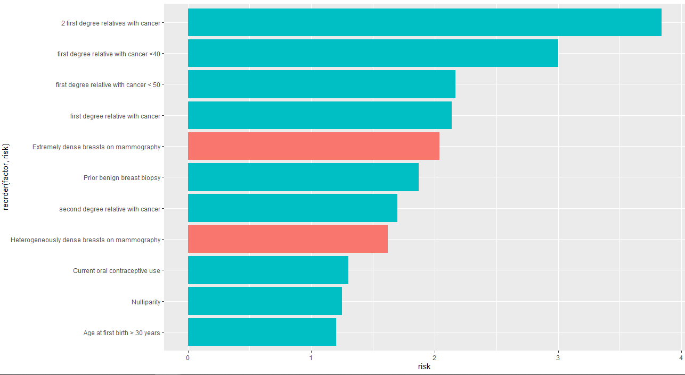
Dense Breasts
Nelson HD, Zakher B, Cantor A, et al. Risk factors for breast cancer for women age 40 to 49: a systematic review and meta-analysis. Ann Intern Med 2012

Slide 4
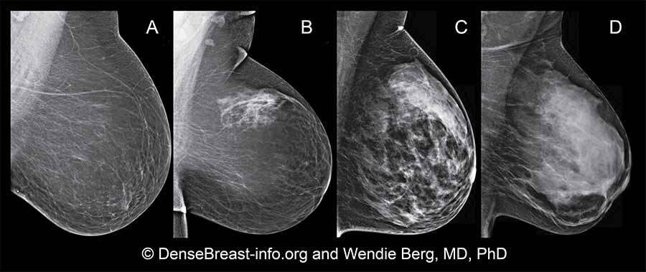
Mammography

Slide 5
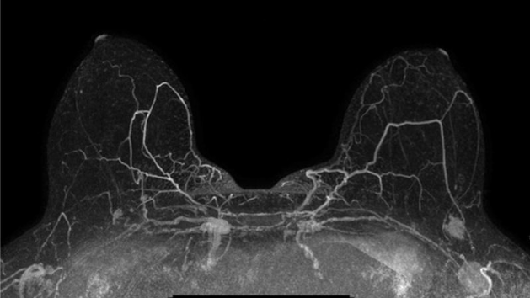
Tomosynthesis (DBT)

Slide 6
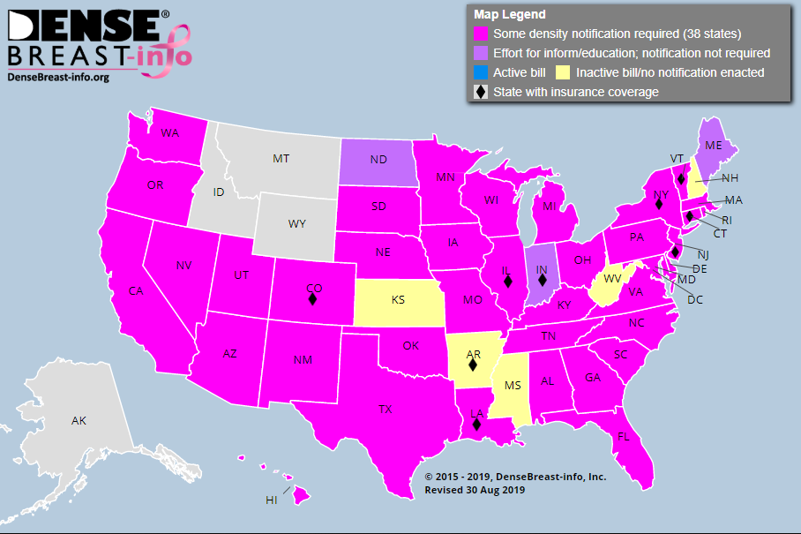

Slide 7
American College of Radiology
ACR’s state chapters have taken varying positions on these bills.
ACR acknowledges there is limited science to provide direction for patients, their primary care providers and breast imagers.
ACR’s Breast Imaging Reporting and Data System (BI-RADS ™) recommends that all mammography reports to referring providers include a description of breast density which physicians should use to discuss appropriate options given a patient’s history and other circumstances. Radiologists categorize density using a 4-level density scale.

Slide 8
American College of Gynecologists & Obstetricians
ACOG does not recommend routine use of alternative or adjunctive tests in women with dense breasts who are asymptomatic and have no additional risk factors.
Screening mammography remains the most useful tool for breast cancer detection and has consistently demonstrated a reduction in breast cancer mortality.
GYN Practice Committee Opinion 625 (2017) discusses prevalence; determination of density by radiologists which is a qualitative, visual assessment; impact of density on cancer risk; masking effect of dense breast tissue which reduces the sensitivity of a mammogram to detect malignancy; and efficacy of digital versus film mammography

Slide 9

Objective
To estimate the cost-effectiveness of a breast density notification law, paired with extended insurance coverage of an DBT for breast cancer screening.

Slide 10
Intervention (vs. standard of care)
If a mammogram determines a woman has greater than 50% dense breasts, insurance will provide a digital breast tomosynthesis (DBT) in lieu of a mammography.

Slide 11
Population
Adult women with clinically dense breasts (>50% fat), age 40-49.
Heterogeneity analysis:
Age 40-64
Family History of Breast Cancer

Slide 12
Framework
Payer perspective
25-year time horizon
3% discount rate
Outcomes: Utility and Life Years
Sample: 20,000,000
Replications*: 10,000

Slide 13
Outcomes
Outcome (Utility) | Women with Dense Breasts | Women without Dense Breasts
No Notification Law
Never Diagnosed with Breast Cancer | 1 | 1
Diagnosed with Breast Cancer (Early)1 | .91 | .91
Diagnosed with Breast Cancer (Late)1 | .45 | .45
Death | 0 | 0
Notification Law with DBT
Notification2 | .99 | 1
False Positive3 | .9899 | 1
Tufts Medical Center. (2019) CEA Registry. Institute for Clinical Research and Health Policy Analysis.
1. Deterministic model includes disutility of negative treatment (ie: infections, nausea, etc.)
2. Excessive screening used as proxy.
3. The annual false positive utility was calculated from a 5-week disutility of obtaining a false positive.

Slide 14
Costs
Cost | $
Test | 0
Notification | 0
Mammogram1 | 100
Digital Breast Tomosynthesis (DBT)1 | 215
Annual BC treatment, early stage2 | 82,121
Annual BC treatment, late stage | 134,682
*Probabilistic analysis uses Gamma distribution to model uncertainty of costs.
1. Center for Medicare and Medicaid (CMS) (2019) Physician Fee Schedule.
2. Blumen, H., Fitch, K., & Polkus, V. (2016). Comparison of Treatment Costs for Breast Cancer, by Tumor Stage and Type of Service. American Health & Drug Benefits, 9(1), 23–32.

Slide 15
Parameters
Parameter | Probability (%)
P(Dense Breasts) | 61.7
P(Cancer | Age) | .1616
P(Early Stage | Cancer) | 94
P(Death | Early Stage Cancer) | 1.1
P(Death | Late Stage Cancer) | 22.82
P(Advance from Early to Late Stage | Cancer) | 15
*Cancer Probability Multiplier for Women with Dense Breasts | 4.7x
*Late Stage Probability Multiplier after year 1 for women with dense breasts | 7x
*Probabilistic analysis uses Binomial distribution to model uncertainty of probabilities and lognormal distribution to model multipliers.
Boyd, N. F., Martin, L. J., Yaffe, M. J., & Minkin, S. (2011). Mammographic density and breast cancer risk: Current understanding and future prospects. Breast Cancer Research : BCR, 13(6), 223. https://doi.org/10.1186/bcr2942
Freer, P. E. (2015). Mammographic Breast Density: Impact on Breast Cancer Risk and Implications for Screening. RadioGraphics, 35(2), 302–315. https://doi.org/10.1148/rg.352140106
McCormack, V. A., & Silva, I. dos S. (2006). Breast Density and Parenchymal Patterns as Markers of Breast Cancer Risk: A Meta-analysis. Cancer Epidemiology and Prevention Biomarkers, 15(6), 1159–1169. https://doi.org/10.1158/1055-9965.EPI-06-0034
Kerlikowske, K., Shepherd, J., Creasman, J., Tice, J. A., Ziv, E., & Cummings, S. R. (2005). Are Breast Density and Bone Mineral Density Independent Risk Factors for Breast Cancer? JNCI: Journal of the National Cancer Institute, 97(5), 368–374. https://doi.org/10.1093/jnci/dji056
Sprague, B. L., Gangnon, R. E., Burt, V., Trentham-Dietz, A., Hampton, J. M., Wellman, R. D., … Miglioretti, D. L. (2014). Prevalence of Mammographically Dense Breasts in the United States. JNCI Journal of the National Cancer Institute, 106(10). https://doi.org/10.1093/jnci/dju255

Slide 16
Assumptions
Each patient will use “Standard of Care” unless notified of risks related to breast density. (strong)
The probability of dense breasts and probability of family cancer history will be treated as independent risk factors. (strong1)
Clinical breast density is 100% accurate (moderate2)
Perfect notification compliance (moderate)
No costs during final year of life. (weak3)
1. Brewer, H. R., Jones, M. E., Schoemaker, M. J., Ashworth, A., & Swerdlow, A. J. (2017). Family history and risk of breast cancer: An analysis accounting for family structure. Breast Cancer Research and Treatment, 165(1), 193–200. https://doi.org/10.1007/s10549-017-4325-2
2. Lee, C. I., Chen, L. E., & Elmore, J. G. (2017). Risk-Based Breast Cancer Screening: Implications of Breast Density. The Medical Clinics of North America, 101(4), 725–741. https://doi.org/10.1016/j.mcna.2017.03.005
3. Chastek, B., Harley, C., Kallich, J., Newcomer, L., Paoli, C. J., & Teitelbaum, A. H. (2012). Health Care Costs for Patients With Cancer at the End of Life. Journal of Oncology Practice, 8(6), 75s–80s. https://doi.org/10.1200/JOP.2011.000469

Slide 17
Patient
Patient notified
Patient uses MRI
Standard of Care
Patient not notified
Standard of care
Diagnosed with Cancer?
Yes
Early
Late
No
Diagnosed with cancer?
No
Yes
Late
Early
Diagnosed with cancer?
Yes
Late
Early
No
Patient does not have dense breasts
Patient has dense breasts
Standard of Care
Diagnosed with Cancer?
No
Yes
Early
Late

Slide 18
Patient
Patient notified
Patient uses DBT
Standard of Care
Patient not notified
Standard of care
Diagnosed with Cancer?
Yes
Early
Late
No
Diagnosed with cancer?
No
Yes
Late
Early
Diagnosed with cancer?
Yes
Late
Early
No
Patient does not have dense breasts
Patient has dense breasts
Standard of Care
Diagnosed with Cancer?
No
Yes
Early
Late

Slide 19
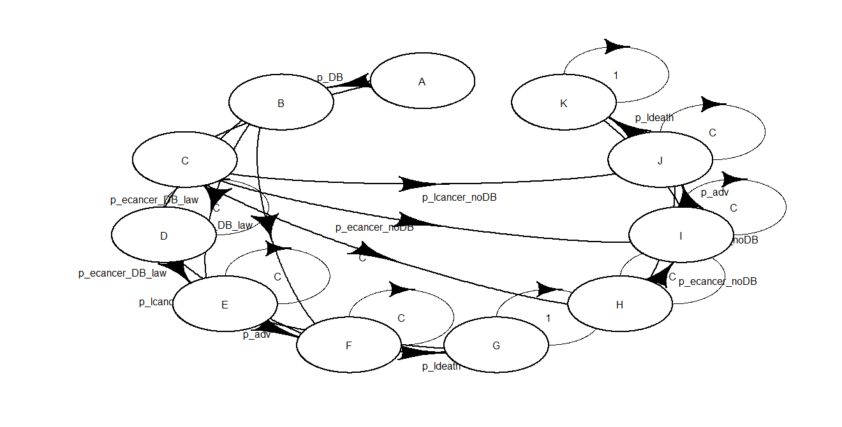

Slide 20
Methodology Conduct CEA in R with a Microsimulation Markov Model
Homogeneous Model (base-case)
Deterministic Model
Probabilistic Model
Non-Homogeneous (Time-Variant)
Heterogeneity Analysis
BCEA: An R package to perform Bayesian Cost-Effectiveness Analysis - Gianluca Baio. (n.d.). Retrieved September 21, 2019, from https://sites.google.com/a/statistica.it/gianluca/bcea
Filipović-Pierucci, A., Zarca, K., & Durand-Zaleski, I. (2017). Markov Models for Health Economic Evaluations: The R Package heemod. ArXiv:1702.03252 [Stat]. Retrieved from http://arxiv.org/abs/1702.03252

Slide 21
Results

Slide 22
Results
Model | Cost Dif. | Effect Dif. (LY) | Effect Dif. (U) | ICER (LY) | ICER (QALY)
Homogeneous | 12,112 | 0.0523 | 0.0367 | 230,884 | 330,401
Probabilistic (10,000 reps) | 12,203 | n/a | 0.0344 | n/a | 354,310
Probabilistic (1,000 reps) | n/a | n/a | n/a | n/a | 319,490

Slide 23

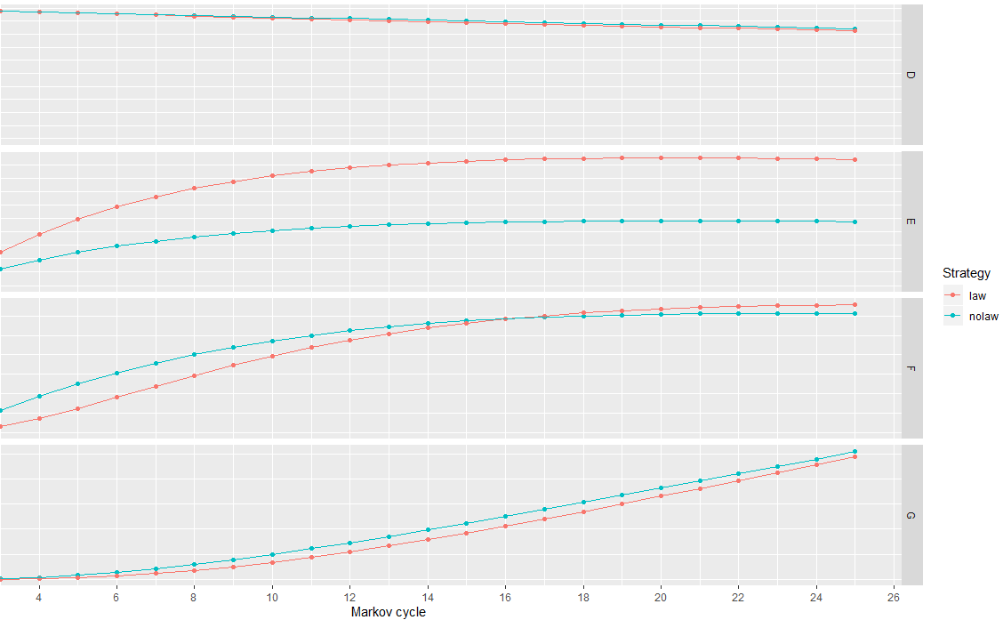

Slide 24
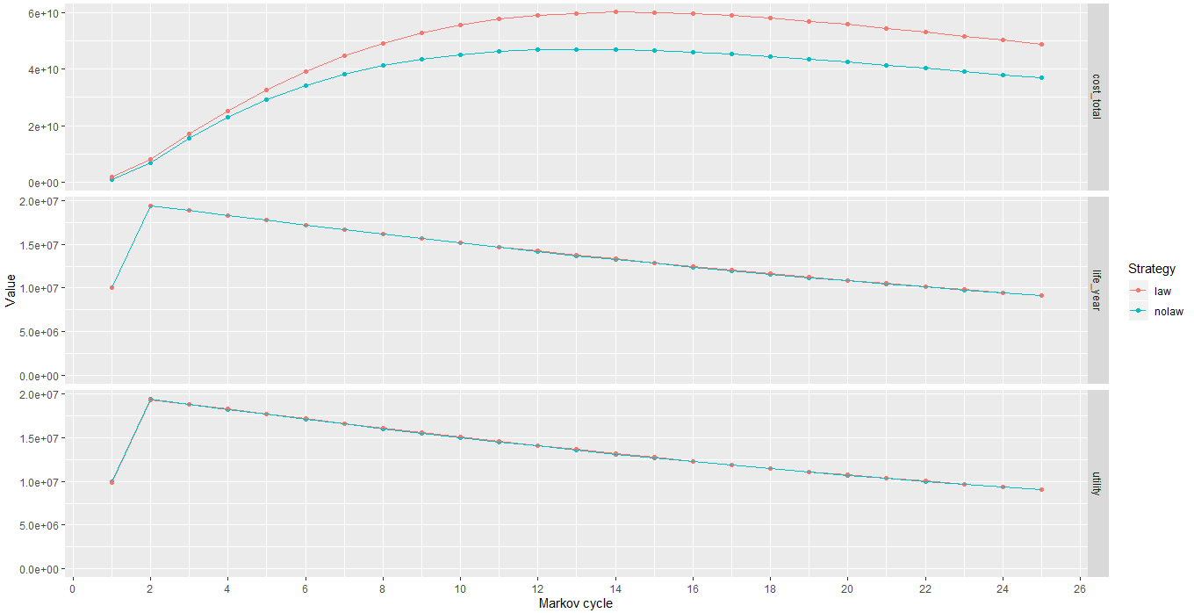

Slide 25
Sensitivity Analysis

Slide 26
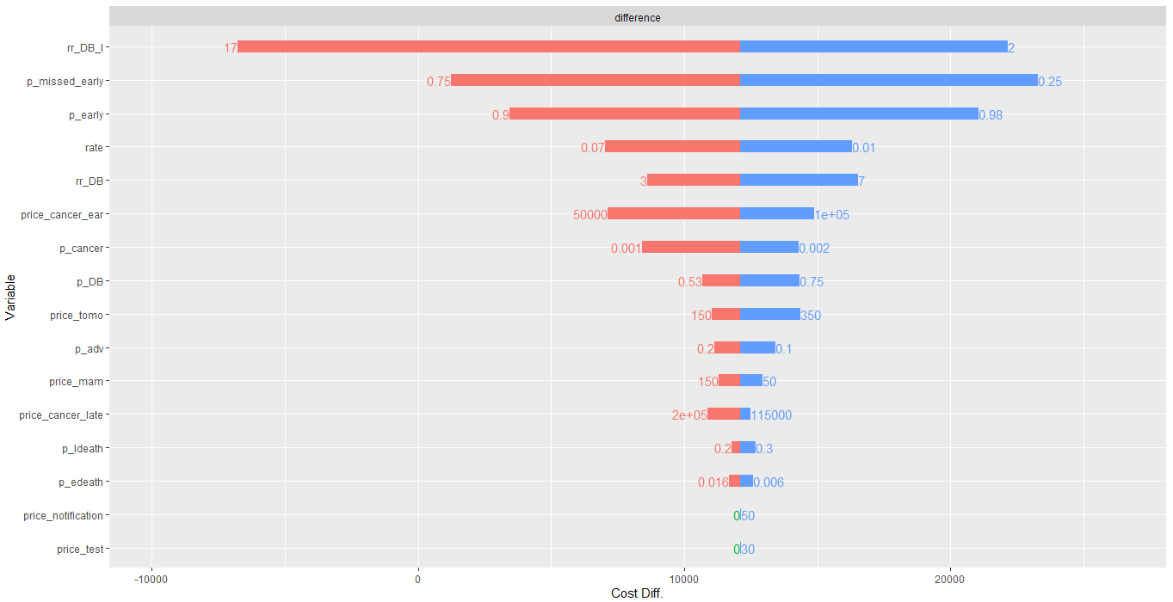
Costs

Slide 27
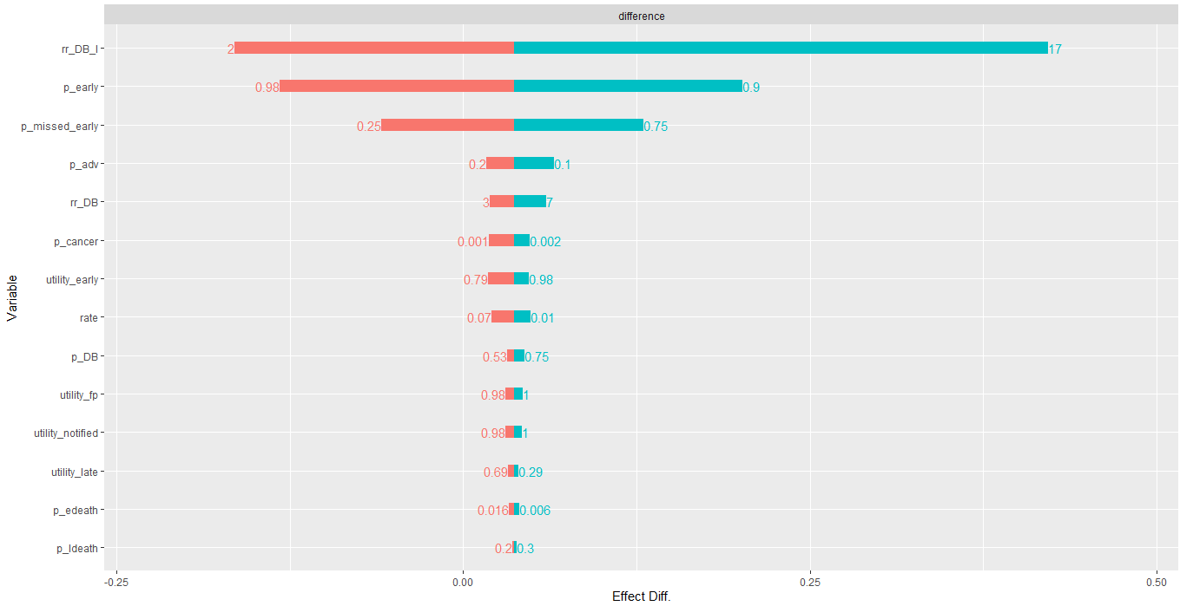
Effect

Slide 28
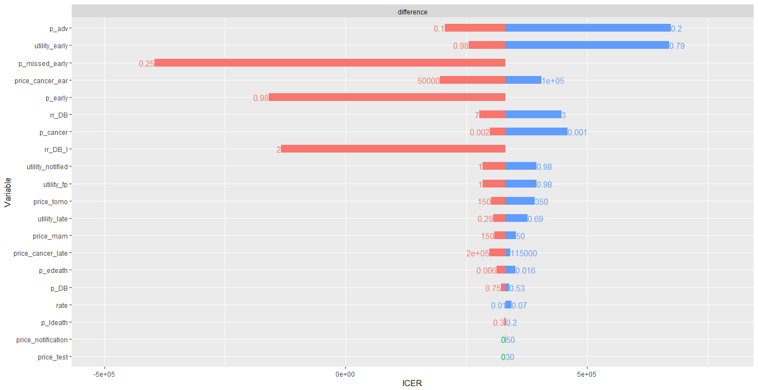
ICER

Slide 29
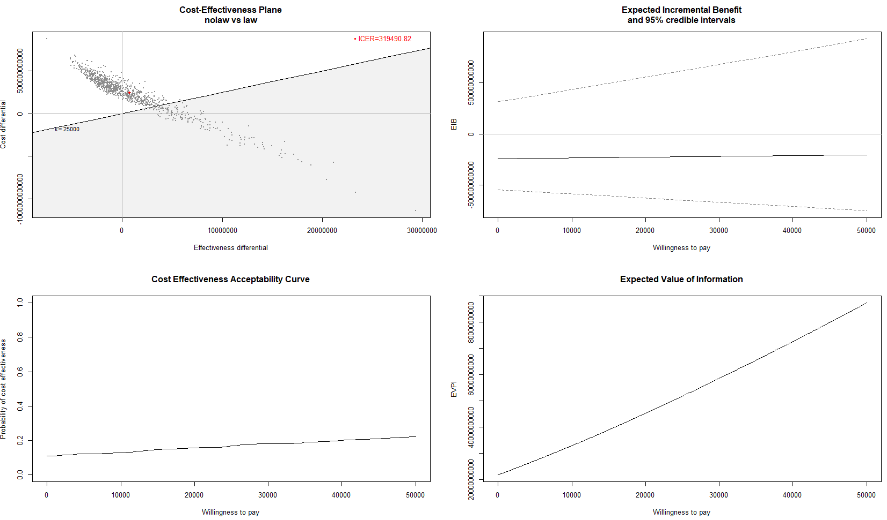

Slide 30
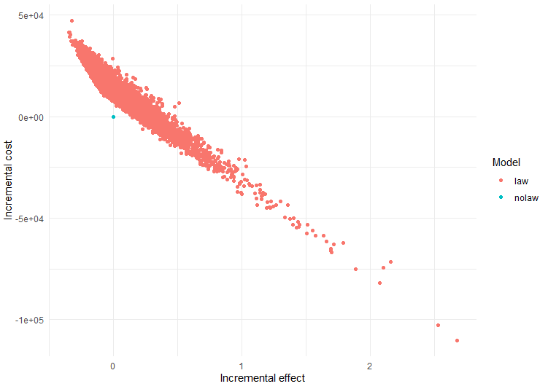

Slide 31
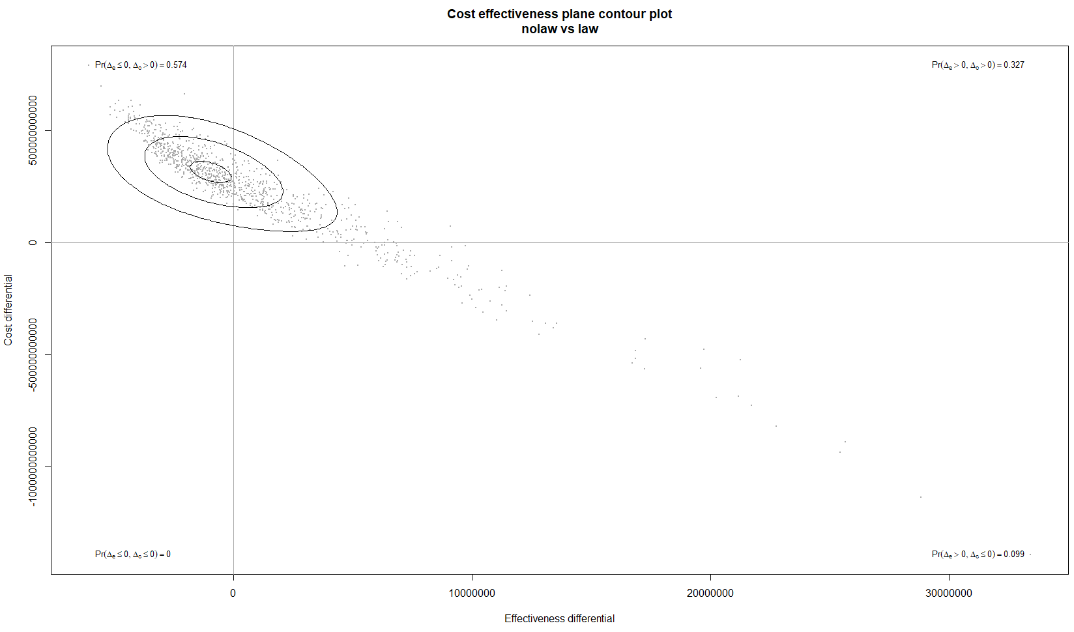

Slide 32
Time-Variant & Heterogeneity Analysis
Model | Cost | Effect (U) | ICER
Base | 10,450 | .0599 | 174,218
Age | 11,292 | 0.0719 | 157,146
Age + Family History | 11,540 | 0.0752 | 153,388
Age + Only 2+ Family History | 11,430 | 0.0736 | 155,358

Slide 33
Limitations
No public perspective
Complexity of breast cancer not fully captured
Model is highly sensitive to risks associated with breast density
Computationally Intensive Model

Slide 34
Strengths
Most data based on meta-analyses
Robust analytical plan using open-source software and validated CEA methodology
Base-model (homogeneous) replicates cost-effectiveness study analyzing the effect of adjunctive digital mammography for women with dense breasts1.
Additional parameters, more complex design, and DBT comparator add new knowledge to field.
Sprague, B. L., Stout, N. K., Schechter, C., van Ravesteyn, N. T., Cevik, M., Alagoz, O., … Tosteson, A. N. (2015). Benefits, harms, and cost-effectiveness of supplemental ultrasonography screening for women with dense breasts. Annals of internal medicine, 162(3), 157–166. doi:10.7326/M14-0692

Slide 35
Implications
Breast density notification laws would result in fewer deaths and increase QALY.
However, the effect is minimal and carries a high-cost.
This study supports the opinion of major provider groups (AACR, ACOG).
While the U.S. may not formally use Cost-Effectiveness as a policy tool, medical associations, boards, and colleges are implicitly using CEA to design standards of care.

Slide 36
Conclusion
Breast density notification laws which provide additional screening via Digital Breast Tomosynthesis is not cost-effective with a willingness to pay threshold of $100,000.

